Slide 1


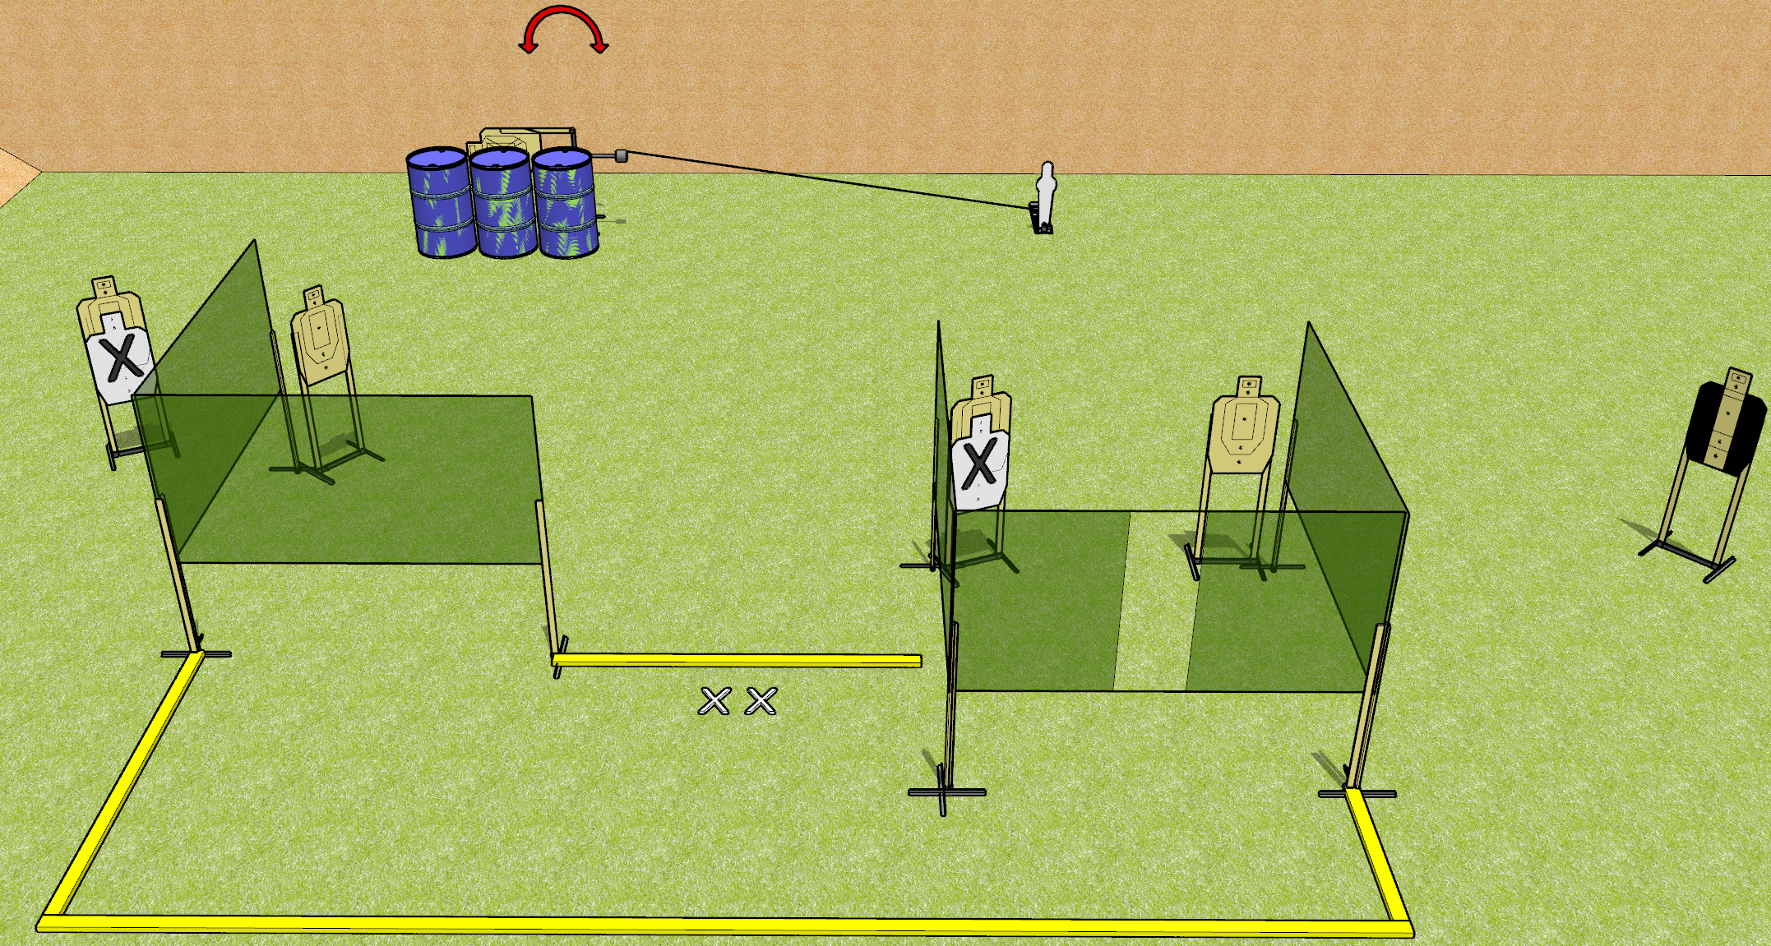
 | Dothan Gun Club – USPSA Match Almost IPSC Course Designer : Drew Coleman
Round Count 13 rounds 6 USPSA 1 mini popper
Equipment List 7 wall feet 1 medium fault line 1 swinger + activator 1 tuxedo

Slide 2
Almost IPSC
Written Stage Briefing
Almost IPSC is a 13 round, 65 point, Comstock course of fire. There are 6 USPSA targets and 1 mini popper. The best 2 hits on paper will score, and steel must fall to score. The start signal is audible.
The swinger is activated by the mini popper, and is visible at rest. Please check the activator prior to walkthrough and set it the same way every time.
Handgun start position is both feet on X’s, wrists below belt. Handgun is loaded and holstered.
PCC start position is both feet on X’s, stock on belt. Loaded carbine is held with both hands, safety on.
On start signal, engage targets as they become available from within the shooting area.

